Slide 1

18ECC205J ANALOG AND DIGITAL COMMUNICATION UNIT-1
S-4 Linear method-Collector modulator
S-5 Non-linear Modulation-Balanced Modulator
S-6 Linear diode detector

Slide 2
GENERATION OF AM WAVES
Linear method-Collector modulator
Non-linear Modulation-Balanced Modulator

Slide 3
Linear modulation
It is operated in the linear region of its transfer characteristics
A>Em
Used in High level modulation
Types
Transistor and switching modulator

Slide 4
Non linear Modulation
It is operated in the non-linear region of its transfer characteristics
A<Em
Used in low level modulation
Types
Square law and Balanced Modulator

Slide 5
Non linearity equation
I=a v1+(av1)2+….

Slide 6
COLLECTOR MODULATOR
The diode modulator does not provide Amplification.
Amplifying device like Transistor and FET can provide amplification. It can be used for amplitude modulation by varying their Gain parameter, if Transistor is used then it is called as collector modulator.
Transistor ---T1---Class c Amplifier---Carrier signal is applied,Vcc is collector supply used for biasing
Transistor---T2--- Class B Amplifier---Message signal is applied,after amplification modulating signal appears across the modulating transformer
Capacitor C offer low path to carrier(prevents carrier to flow in modulating transformer)

Slide 7
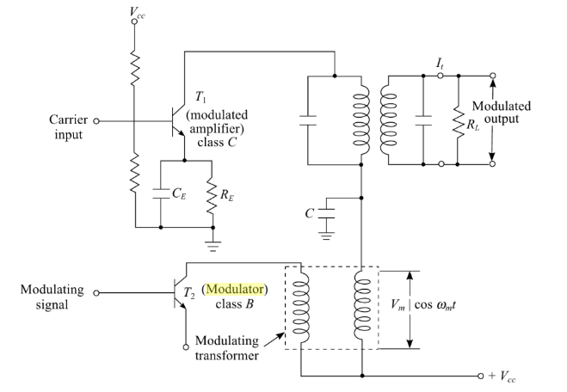
Collector Modulator Circuit

Slide 8

Principle of operation
The output voltage is replica of input voltage
The amplitude of output voltage is equal to Vcc ,When there is no message signal(fig a)
When Message signal is applied,the net effect is slow variation in output(fig b)
The slow varying supply voltage Vc is given by

Slide 9
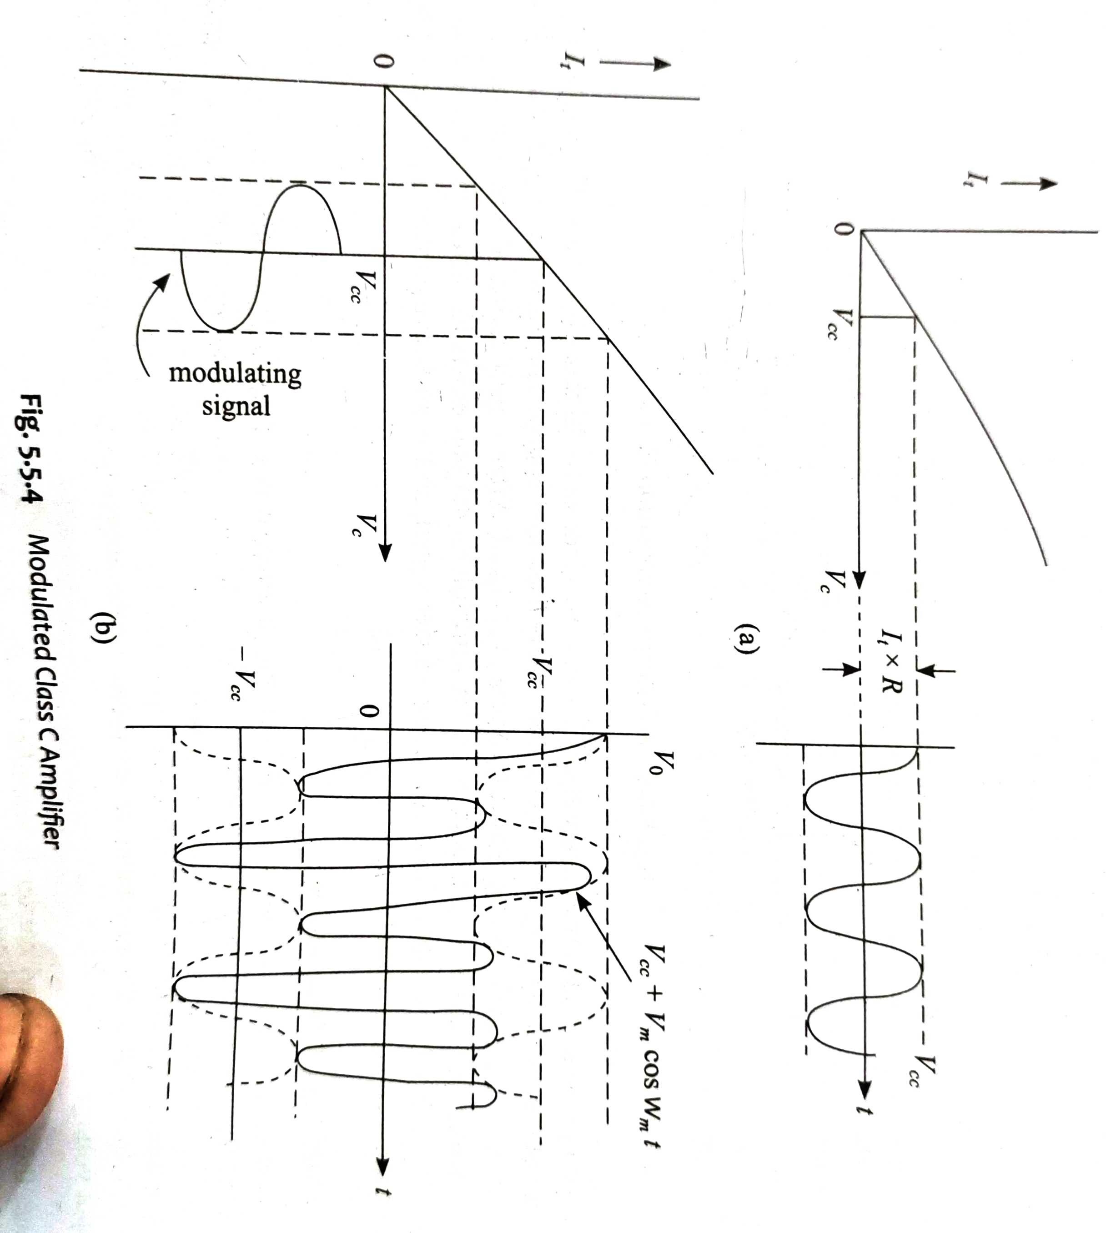

Slide 10
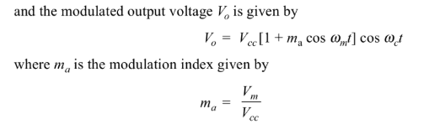
.
OVER MODULATION

Slide 11
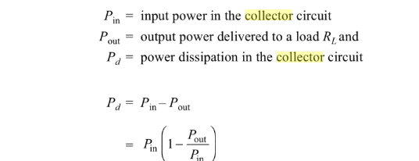

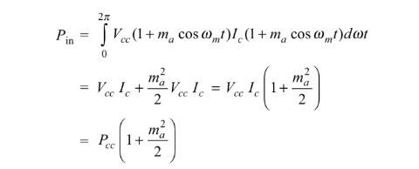
Collector circuit efficiency

Slide 12




.

Slide 13
BALANCED MODULATOR
A simple diode can be used as non linear modulator by restricting its operation to non-linear region of its characteristic.
The diode modulator does not provide amplification, this limitation can be overcome by using amplifying device like transistor ,FET or an electron tube in balanced mode.
The circuit is similar to AM-SC generation,except that the feeding point of carrier and modulating signals are interchanged.

Slide 14
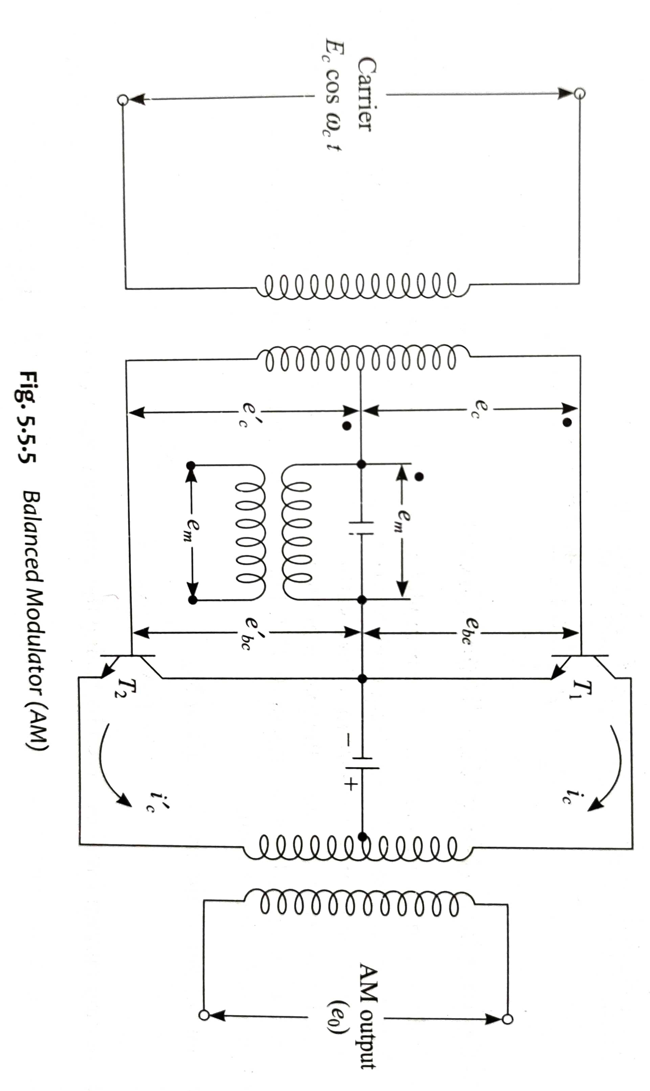
Balanced Modulator

Slide 15
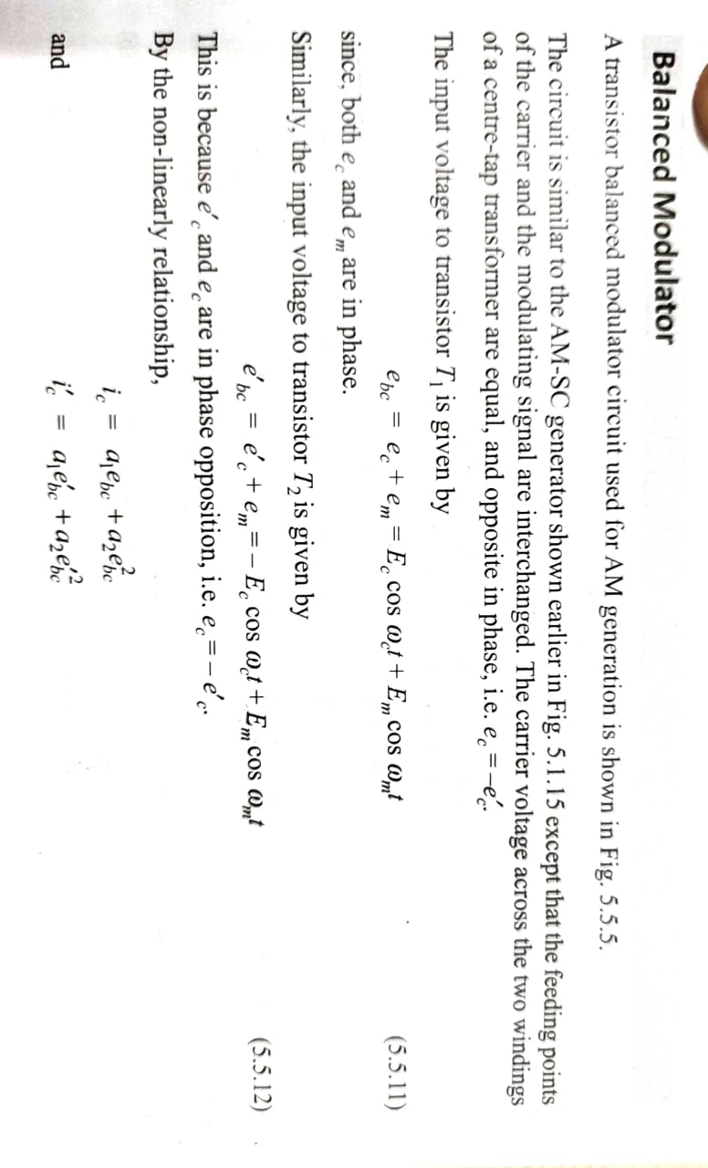

Slide 16
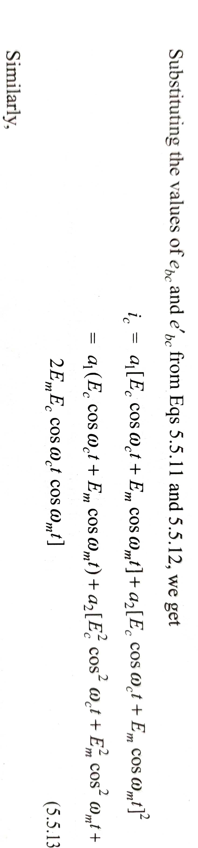

Slide 17
Advantages of balanced modulator
In simple non-linear circuits ,the undesired non-linear terms are eliminated by bandpass filter. Hence bandpass filter must be carefully designed.
In balanced modulator ,the undesired non-linear terms are automatically eliminated. The output will have only desired terms.

Slide 18
Demodulation of AM Wave-Linear diode detector
A diode operates in the linear region ,can extract the envelope of an AM wave. Such a detector is called envelope detector.
This detector is popular in commercial radio receivers circuits ,it is very simple and less expensive.
Tuned transformer provides perfect tuning at desired carrier frequency.
R-C forms the time constant network.
When modulated carrier at the input of diode is 1v,the operation takes place in the linear region

Slide 19
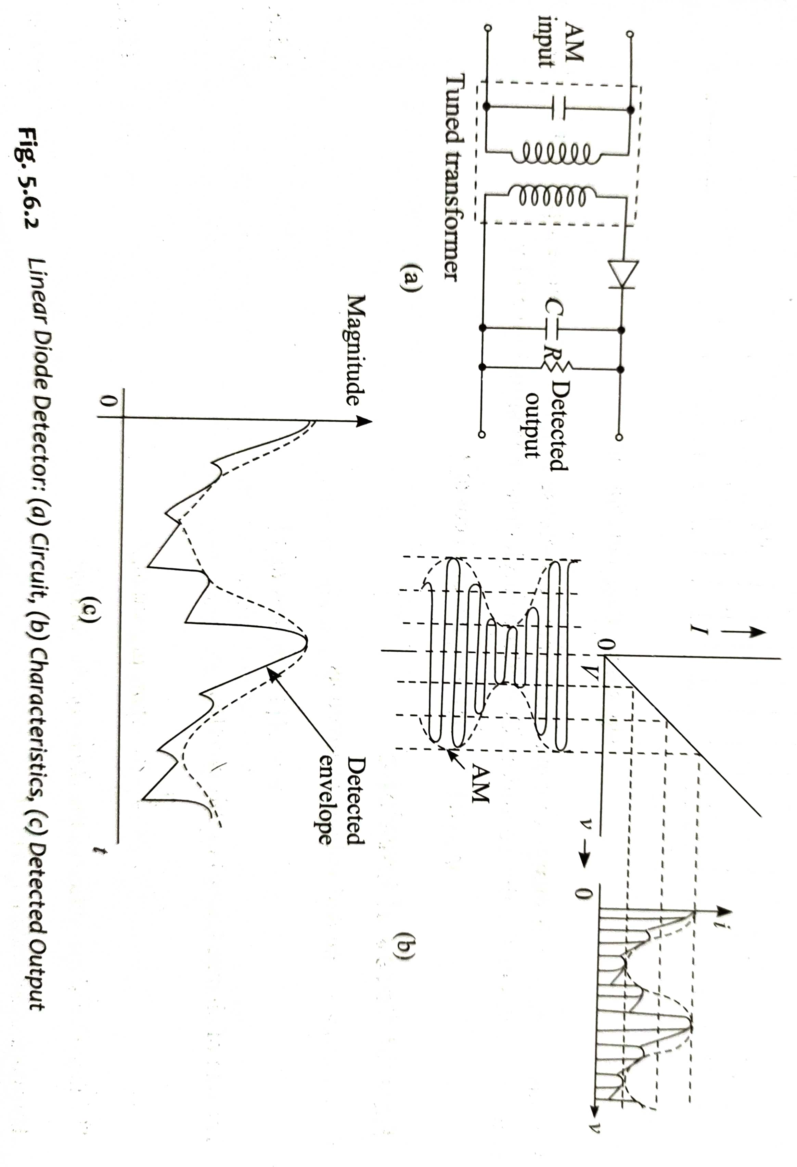
Linear diode detector (a)circuit (b)Characteristics (c)Detected output

Slide 20
operation
Assume Capacitor is absent in the circuit,then output will be like half-rectified as shown in fig b.
The diode will provide low resistance rd.
The total resistance will be rd+R.
For positive half cycle ,the capacitor is charged to peak.
For negative half cycle ,the diode is reverse biased and carrier voltage is disconnected from R-C circuit.
capacitor starts discharging through resistor with time constant.
If time constant is choosen properly,the voltage across the capacitor doesnot falls below
The voltage across the capacitor will be like spiky base band as shown in figure c.

Slide 21
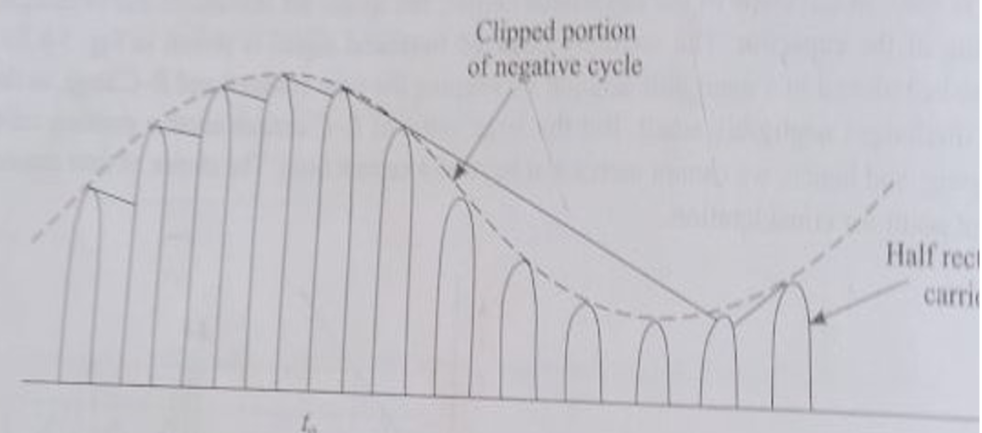
Diagonal clipping

Slide 22

Choosing time constant RC
IF RC is too high-cause diagonal clipping
The optimum value of time constant has to be chosen which provides a compromise between the following two facts

Slide 23
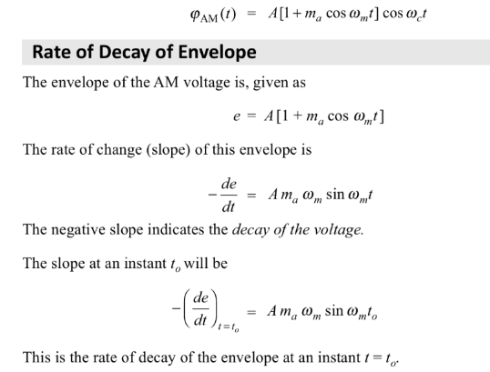
.

Slide 24
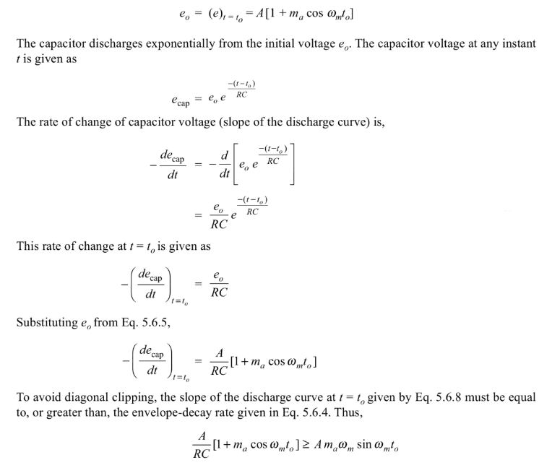
At t=to

Slide 25
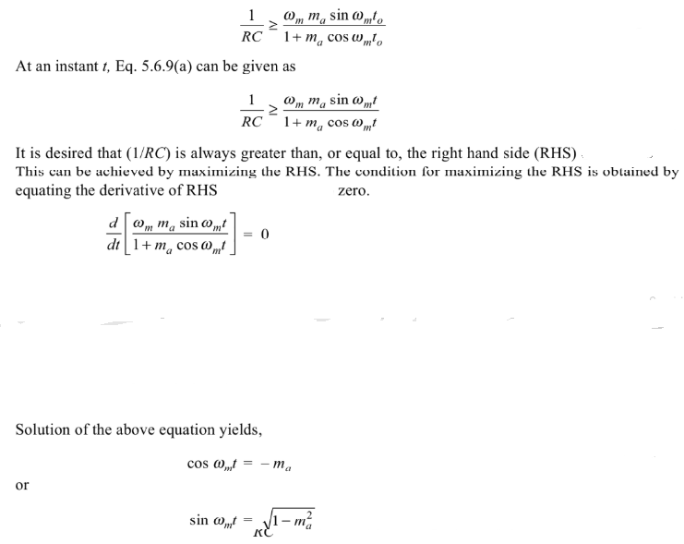
.

Slide 26
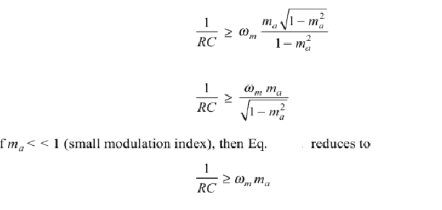
.

Slide 27
Numericals
.

Slide 28
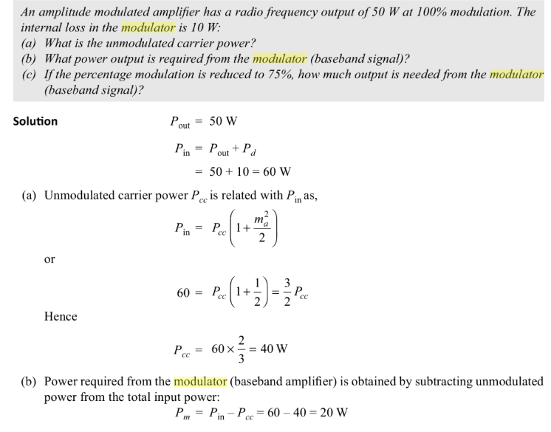
.

Slide 29

.

Slide 30



